Slide 1
DECISION TREE: PART A GRADED ASSIGNMENT CREDIT SCORING
NEELAM AGARWAL
User ID: Jig11670

Slide 2
PROBLEM STATEMENT
IDIDI Bank wants to improve the profitability of its consumer loan department. The bank has seen a high default rate on its loans between 2 to 5 years of tenure and wants to tighten its credit policy. With the help of decision tree outputs showcased in above image, provide your interpretation of the analysis and observed recommendations or insights on a PPT slide.

Slide 3
Problem Assessment
In this problem, the data of the customers is given, decision tree is built based on the important attributes.
The bank wants to know the cream of its customer base to tap on; to decrease the default and improve customer’s quality
Also the bank wants to know where to be cautious and avoid giving loan

Slide 4
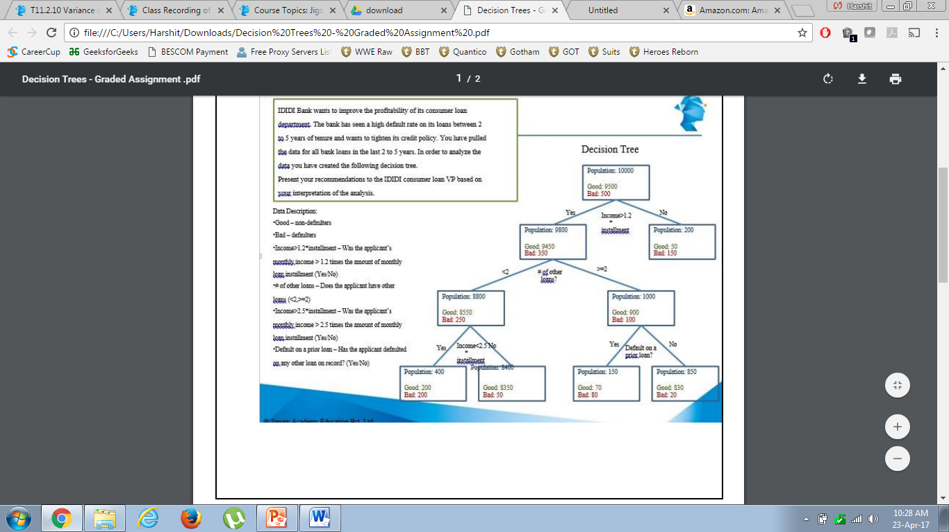
DECISION TREE

Slide 5
OBSERVATION
It is a classification tree as the output is Binary
In the above Decision Tree we observe that there are three important attributes based on which the decision tree is built
Installment in relation with income
Number of loans
Default on previous loan
There are 4 Decision nodes and 5 Terminal nodes

Slide 6
Findings
Customer whose income is less than 1.2 times of installment amount, more default is observed.
Customer whose income is more than 2.5 times of installment amount, have performed very well in comparison with customers with less than 2.5 times of installment amount.
Figures for point no. 1 and 2

Slide 7
Findings
Customer who had defaulted previously and had more than two loans at the time of applying for our loan have performed significantly bad.

Slide 8
Policies that can be implemented
Installment should not exceed income/1.2 (as BAD rate is 75% when installment is exceeding income/1.2).
Customers with more than two loan and have defaulted earlier - the combination of these customer should be strictly avoided
Customers with income more than 2.5 times of installment amount ( installment = income/2.5) is the segment we need to focus on with a very good response rate.

